Slide 1
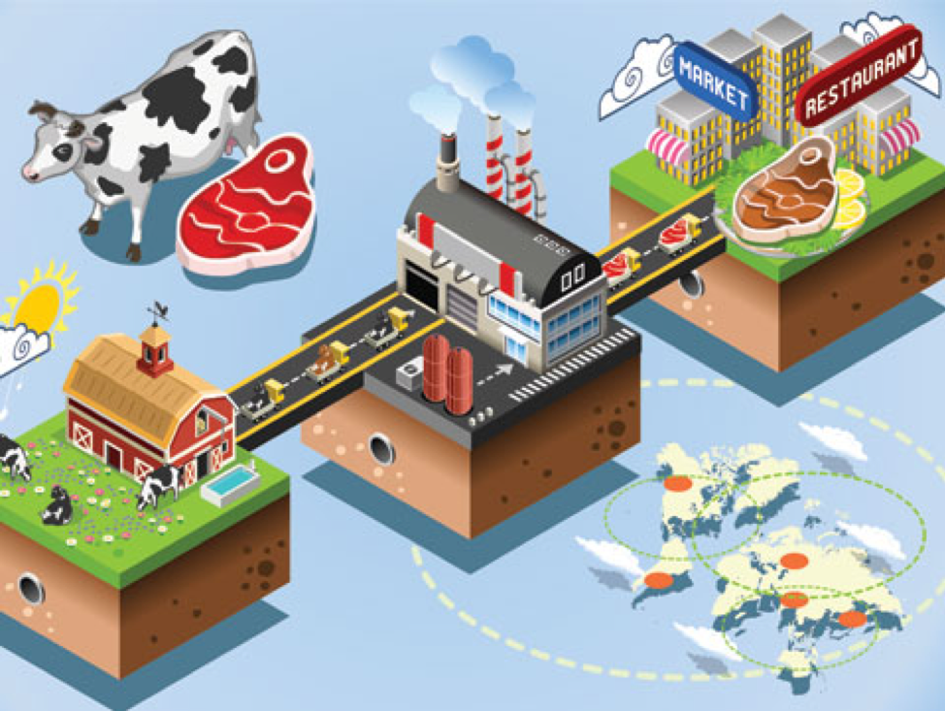
Application of blockchain technology
for Traceability in Food Chains
By Yelena Klairmont
Supply

Slide 2
In light of numerous recent food recalls, the importance of being able to trace
the source of food from farm and factory to table is crucial,
and Blockchain technology is a logical way to support this traceability.
Last summer, Cargill Meat issued a recall of 132,606 pounds of ground beef due to a deadly e. coli outbreak, which caused 18 cases of illness, including one death.
A 2015 study at Ohio State University, estimated the annual cost of
medical treatment, lost productivity, and illness-related mortality at
$55.5 billion.
Asociate professor at Ohio State University, Robert Scharff

Slide 3
According to the Centers for Disease Control and Prevention (CDC), in 2016, there were 839 food-borne disease outbreaks, resulting in 14,259 illnesses, 875 hospitalizations, 17 deaths, and 18 food product recalls.
http://fortune.com/food-contamination/https://wwwnc.cdc.gov/eid/article/17/1/p1-1101_article

Slide 4
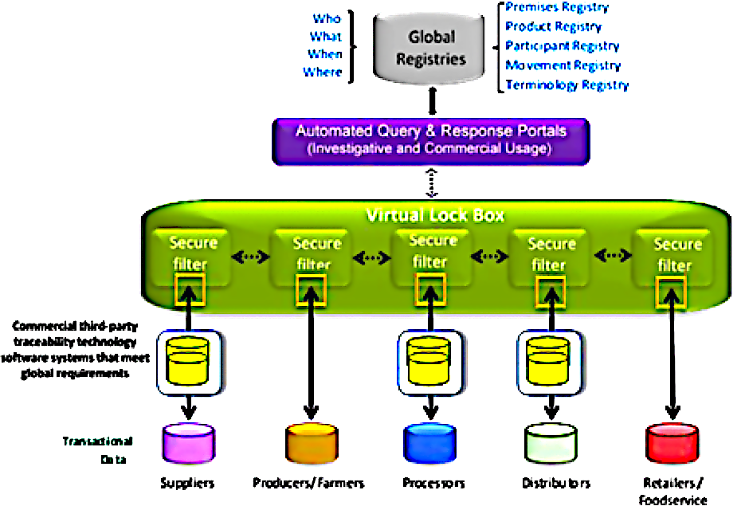
Solution: Blockchain application in food traceability.
Proposal: Amendment to BLOCKCHAIN TECHNOLOGY ACT in Illinois.
https://www.produmex.com/blockchain-food-safety-integrity/

Slide 5
What is Blockchain?
The term “blockchain” was first used by Satoshi Nakamoto, a pseudonymous person or entity, in a 2008 paper conceptualizing chronological blocks of data linked through a networked cryptologic chain. It operates on decentralized data housing, relying on encryption for data verification and assurance.
Based on this concept, Nakamoto created Bitcoin, called cryptocurrency, where transactions are made without an established intermediary, (i.e. banks).
Although most blockchain applications have been used in cryptocurrency exchange, the framework can be applied to any scenario that requires assured/verified information.
https://en.wikipedia.org/wiki/Satoshi_Nakamoto

Slide 6
Blockchain uses hash-based cryptology to assure security and trust.
Hash is an encrypted sequence of characters where it is computationally impossible to derive the original without a “key.”
This information is publicly available for those within the system only, and no participant can modify a transaction after it has been recorded on the ledger.
Ledgers are an inherent tool of business, and blockchain uses technology to improve on some of the disadvantages of private ledgers.
If an error occurs, a new transaction must be used to reverse it. At that point, both Blockchains become “immutable digital ledgers” chronologically and publicly recorded where each participant in the network can look at the blockchain and see evidence of all transactions and changes to the information added to the record
chain.https://blog.cryptographyengineering.com/2018/04/07/hash-based-signatures-an-illustrated-primer/

Slide 7
The value of blockchain use in traceability systems is based on:
The rapidity of querying the system
The simultaneous capabilities of anonymity and transparency: companies can input traceability information while keeping important proprietary or business-competitive information hidden.
The immutable and shared nature of the system: participants - growers, suppliers, processors, distributors, retailers, regulators and consumers - can each gain permissioned access to updated copy of the shared ledger with trusted information, and the origin and state of food for their transactions.
Each transaction is confirmed online by buyers and sellers at the time of occurrence
https://www.wlj.net/top_headlines/what-is-blockchain/article_9a57d0a2-1e56-11e8-b1ab-
U.S. Department of Commerce’s National Institute of Standards and Technology (NIST)
https://www.wlj.net/top_headlines/what-is-blockchain/article_9a57d0a2-1e56-11e8-b1ab-5bc37e7407ce.html

Slide 8
Why should stakeholders be interested in blockchain application:
Issues:
Food safety, cross-contamination, spread of food-borne illness, accelerated number of food recalls.
Lack of access to information and traceability leads to unnecessary waste and the economic burden of recalls, taking weeks or even months to identify the precise point of contamination.
Inability of providers to quickly trace contaminated products to its source, causing further illness, lost revenue and wasted products.

Slide 9
In summer of 2018, Walmart Vice President of Food Safety and Health, Frank Yiannas, experimented with a package of Mangoes, and found that Blockchain was able to accelerate the time it took to track this package, from two weeks to two seconds.
Yiannas announced that Walmart is getting its suppliers to put food on a Blockchain, to reduce waste, as well as improve contamination management and transparency.

Slide 10
Blockchain will make the food supply chain safer, more efficient and more sustainable. By gaining visibility and accountability in each step of the food supply, it will enable food providers and other members of the network to trace contaminated product to its source in seconds – not weeks, remove it from store shelves, thereby halting the spread of illnesses, mitigating cross-contamination, improving freshness, increasing shelf life and reducing product loss, unnecessary waste and the economic burden of recalls.
Blockchain can help ensure quality of goods, track authenticity of products and certify provenance across the entire supply chain, establishing a trusted environment for all transactions, prove sustainability of products by securely managing the entire supply chain, and gaining consumers’ trust.
Blockchain can securely and transparently upload, manage and access transactional data to trace the location and status of food products on the supply chain in order to better manage demand, food waste and freshness.
https://www.wlj.net/top_headlines/what-is-blockchain/article_9a57d0a2-1e56-11e8-b1ab-5bc37e7407ce.html
http://fortune.com/food-contamination/https://wwwnc.cdc.gov/eid/article/17/1/p1-1101_article
http://www.ncsl.org/research/agriculture-and-rural-development/food-safety-modernization-act.aspx

Slide 11
The Next Step: Blockchain for cattle
BENEFITS OF BLOCKCHAIN TO THE BEEF INDUSTRY
The AgCenter outlined why application of blockchain system will benefit the cattle industry:
Million dollars worth of cattle are stolen and resold each year. Those sales would be impossible without proof of title.
Blockchain technology could be used for animal identification, cattle sales, and to prevent cattle theft and food fraud, further reducing costs to producers.

Slide 12
Animal ID system Animal ID has the support of most largest beef processors, a majority of the largest feeding companies and many of the largest breeders. Together with the Blockchains, it could make material changes to the ways people do business. Each animal will have a record, name of the lender, contact person. Electronic notices will be transmitted by the SmartContracts.
A Block might contain the following fields of information:
Date and time of transaction;
Seller;
Buyer;
Number of head;
Type;
Quality;
Sex;
Base weight;
Spot or forward market—[‘S’] or [‘F’] If forward list the month and basis to the most forward CME futures contract price or basis to futures month;
Slide;
GPS point of delivery;
Delivery date range;
Background—health and implants.”
https://www.wlj.net/top_headlines/what-is-blockchain/article_9a57d0a2-1e56-11e8-b1ab-5bc37e7407ce.html

Slide 13
Supply Chain: consumers want to know more about who produces the beef they consume and how it is produced. Blockchains provide the link from consumer all the way back to the breeder. Consumers can use a smart phone to scan the package on the beef counter at the grocery store and find out all they would like to know about the product they are selecting. This will provide confidence and eliminate dishonest mislabeling occurring across the country every day.
Traceback/Traceability will assure good title and provide a secure pathway for transfer of ownership and title with each transaction.Traceback is already in place in other competing beef producing countries in the global marketplace.
February 2018, Will O’Brien (who@tbp.com)
Beef Blockchain - Ag Center
www.agcenter.com/.../THE%20BEEF%20BLOCKCHAIN%202018.docx
https://www.wlj.net/top_headlines/what-is-blockchain/article_9a57d0a2-1e56-11e8-b1ab-5bc37e7407ce.html

Slide 14
The AgCenter suggests blockchain for animal identification and transparency, proposing the creation of a National Beef Blockchain being placed in the hands of industry with an elected governance board, working with the USDA’s Animal and Plant Health Inspection Service.
“Members from each industry sector would set the rules for data collection, for animal ID, and for Block creation. http://www.tbp.com/Personal.aspx
????? Maybe not a good idea, subjective standard by insiders in this industry???

Slide 15
Federal Government Stakeholders:
https://csrc.nist.gov/CSRC/media/Publications/nistir/8202/draft/documents/nistir8202-draft.pdf

Slide 16
In 2018, Department of Commerce’s National Institute of Standards and Technology, concluded that:
Blockchain will reduce waste, improve contamination management and transparency.
Identify and remove recalled foods from its products list.
Verify any information about products and will be protected from hacking attacks and data alterations.
https://csrc.nist.gov/CSRC/media/Publications/nistir/8202/draft/documents/nistir8202-draft.pdf

Slide 17
State Of Illinois Government champions:
The Illinois Blockchain Initiative is exploring blockchain’s impact on government, and is collaborative effort to position Illinois as a leader in blockchain innovation. https://illinoisblockchain.tech
Illinois Legislative Blockchain and Distributed Ledger Task Force Meeting Agenda (10-17-17)
Illinois Blockchain Task Force Final Report (02-05-18)
Task Force Members:

Slide 18
Government champions:
Blockchain Entrepreneurship Incubator Task Force Members:
Co-Chairman: State Representative Michael J. Zalewski – 23st District
Co-Chairman: Ari Scharg – Edelson PC
State Representative Jaime M. Andradre Jr. – 40th District State Representative
Jennifer M. O’Rourke – Illinois Blockchain Business Liaison, Illinois Department of Commerce and Economic Opportunity at jennifer.orourke@illinois.gov.
Cab Morris – Deputy Director of Strategy and Operational Performance Illinois Department of Financial and Professional Regulation at richard.morris@illinois.gov
https://www2.illinois.gov/sites/doit/Strategy/Documents/BlockchainTaskForceFinalReport020518.pdf

Slide 19
 | IL Blockchain Initiative
Cab Morris, Deputy Director of Strategy and Operational Performance Illinois Department of Financial and Professional Regulation richard.morris@illinois.gov ,
Jennifer O’Rourke, Illinois Blockchain Business Liaison, Illinois Department of Commerce and Economic Opportunity at jennifer.orourke@illinois.gov.,
John Mirkovic ,Cook County Recorder of Deeds,
Carie Cycholl – Illinois Department of Innovation and Technology.
BlockchainEntrepreneurshipGovernmentIncubatorNews

Slide 20
Michael Wons – Illinois Department of Innovation and Technology
Bryan A. Schneider – Illinois Department of Financial and Professional Regulation Fred Moore – Illinois Department of Insurance
Mike Standley – Illinois Secretary of State
John Mirkovic – Cook County Recorder of Deeds
Kevin McDermott – Cook County Clerk’s Office
Shamlan Siddiqi – NTT Data
Manuel Flores – Glass Mountain Capital, LLC
John Karantonis – geopay.me
Tom Rooney – 27th District State Senator
John F. Curran – 41st District
Keith R. Wheeler – 50th District State Senator

Slide 21
Blockchain initiatives in Illinois:
The Blockchain Initiative Illinois Partners with Evernym to Launch Birth Registration Pilot to provide secure digital identity solutions for Illinois citizens during the birth registration process.
Evernym was founded in 2013, develops software solutions that leverage distributed ledgers to provide every individual, organization and connected device with secure and irrevocable identity. Evernym - self-sovereign identity solutions evernym.com.
https://illinoisblockchain.tech/illinois-partners-with-evernym-to-launch-birth-registration-pilot-f2668664f67c
Blockchain Cook County — Distributed Ledgers for Land Records
Blockchain’s Transformational Potential for Medicaid
State of Illinois: Leslie Strain; 312.597.3699; leslie.strain@illinois.gov
https://illinoisblockchain.tech

Slide 22
Government Stakeholders:
FDA
Illinois Council on Food and Agricultural Research
https://www2.illinois.gov/sites/doit/Pages/BlockChainInitiative.aspx

Slide 23
On 9/28/2017, Bill HR0120 was introduced by House Sponsor, Rep. Michael J. Zalewski.
It established BLOCKCHAIN TASK FORCE, creating the Illinois Legislative Blockchain and Distributed Ledger Task Force to study how and if the State of Illinois, county governments, and municipal governments can benefit from a transition to a blockchain based system for record-keeping and service delivery.
http://www.ilga.gov/legislation/BillStatus.asp?DocNum=120&GAID=14&DocTypeID=HR&LegID=104110&SessionID=91&GA=100&SpecSess=0

Slide 24
Date | Chamber | Action
5/31/2018 |  | Rule 3-9(a) / Re-referred to Assignments
Champions and Stakeholders:
On 5/13/2018, Senate introduced Bill HB5553: BLOCKCHAIN TECHNOLOGY ACT House Sponsors Rep. Michael J. Zalewski - Keith R. Wheeler - Jaime M. Andrade, Jr. - Jonathan Carroll - Brian W. Stewart and Mike Fortner Senate Sponsors (Sen. Toi W. Hutchinson - Linda Holmes - Cristina Castro)
Synopsis As Introduced: Creates the Blockchain Technology Act. Provides for the permitted uses of blockchain technology in transactions and proceedings. Provides limitations to the use of blockchain technology. Prohibits units of local government from implementing specified restrictions on the use of blockchain technology. Preempts home rule. Defines terms.

Slide 25
Policy Action Plan I
Write a letter to Illinois House and Senate Sponsors of BLOCKCHAIN TECHNOLOGY ACT to amend proposed ACT in Illinois, by adding Blockchain application in Food Chain Traceability:
Section 2/page 5,
The implementation of Blockchain technology in Food Chain Traceability, shall promote food safety, create transparency, and quick traceability of contaminated products to its source. It will prevent the economic burden of recalls and spread of food-borne illness, lost revenue and wasted products.
Section 2/ page 5, line 12(b) Nothing in this Section prohibits a unit of local government from using a blockchain or smart contract in the performance of its powers or duties in a manner not inconsistent with the provisions of this Act.

Slide 26
Representative Michael J. Zalewski (D)
23rd District
Email: info@repmikezalewski.org
District Office:
1 Riverside Road
Suite 204 A
Riverside, IL 60546
(708) 442-6500
(708) 442-6501 FAX
Years served: December 2008 - Present Committee assignments: Cybersecurity, Data Analytics, & IT; Elections & Campaign Finance; Health Care Licenses; Higher Education; Insurance: Health & Life; Personnel & Pensions (Vice-Chairperson); Revenue & Finance (Chairperson); Property Tax Subcommittee (Sub-Chairperson); Sales and Other Taxes Subcommittee; Finance Subcommittee; Growth, Reform & Fairness Subcommit (Sub-Chairperson); Campaign Finance Subcommittee; Ballot Access Subcommittee (Sub-Chairperson); Higher Education Analysis Subcommit; Distributed Ledgers & Biography: Attorney; born in Chicago; B.A., Political Science, University of Illinois at Urbana-Champaign; J.D., John Marshall Law School; Attorney specializing in civil and criminal law; married (wife, Carrie).
Springfield Office:
243-E Stratton Office Building
Springfield, IL 62706
(217) 782-5280

Slide 27
Representative Keith R. Wheeler (R) 50th District Republican Conference Chairperson
Years served: January 2015 - Present Committee assignments: Appropriations-General Service; Construction Industry & Code Enforc; Cybersecurity, Data Analytics, & IT; Economic Opportunity; Health Care Licenses; Labor & Commerce Committee; Mass Transit; Public Utilities; Workers Compensation Subcommittee; Distributed Ledgers & Cryptocurrenc. Biography: Graduated from Oswego High School '85; earned a B.A. degree in Economics from the University of Illinois; owner of Responsive Network Service for over 23 years with offices in Chicago and Oswego; past Chairman of NFIB Illinois Leadership Council; past Board Chairman for the Aurora Regional Chamber of Commerce; past Chairman of the Kendall County Republican Central Committee; Treasurer of the Oswego Bears Youth Football and Cheer Pop Warner program; wife Lisa; three children, Matthew, Chad, and Ava.
Springfield Office:
200-5N Stratton Office Building
Springfield, IL 62706
(217) 782-1486
District Office:
959 Oak Street
North Aurora, IL 60542
(630) 345-3464
Email: office@repkeithwheeler.org
Associated Senator(s): | Jim Oberweis

Slide 28
Representative Jaime M. Andrade, Jr. (D) 40th District
Springfield Office:
260-W Stratton Office Building
Springfield, IL 62706
(217) 782-811
District Office:
3007 W. Irving Park Rd.
Suite A-Front
Chicago, IL 60616
(773) 267-2880
(773) 267-2840 FAX
Email: staterep40@gmail.com
Years served: August 2013 - Present
Committee assignments: Business & Occupational Licenses; Construction Industry & Code Enforc; Cybersecurity, Data Analytics, & IT (Chairperson); Financial Institutions (Vice-Chairperson); Human Services; Mass Transit; Transportation: Regulation, Roads; Distributed Ledgers & Cryptocurrenc.
Biography: Born Oct. 7, 1972 in Chicago; graduate, St. Andrew's Grade School and Gordon Technical High School; B.S.B. in Accountancy from DePaul University, Driehaus College of Business (cum laude); post-graduate studies at DePaul University; founding board member, Cardinal Bernardin Early Childhood Center; has worked with the North River Commission, Rincon Family Services' Avondale Coalition, and Albany Park Neighborhood Council; former member, Active Citizens Team/Neighborhood On Watch and Keep Chicago Renting Coalition; married, has two children.
Associated Senator(s): | Iris Y. Martinez

Slide 29
Representative Jonathan Carroll (D) 57th District
Springfield Office:
241-E Stratton Office Building
Springfield, IL 62706
(217) 558-1004
Committee assignments: Elem Sec Ed: Charter School Policy; Mass Transit; Government Consolidation & Modern; Cybersecurity, Data Analytics, & IT; Government Consolidation Analysis.
District Office:
830 S. Buffalo Grove Rd.
Suite 120
Buffalo Grove, IL 60089
(847) 229-5499
(847) 377-9497 FAX
Biography: Special Education Teacher and Learning Disability Advocate; M.A.in Learning Disabilities from Northeastern Illinois University, B.A. in Communications from DePaul. Advocate for those who have ADHD and executive functioning issues in order to help them meet personal, professional and educational goals. Belongs to Temple Beth El in Northbrook. Resides in Northbrook with wife Katrina and two children.
Email: repjonathancarroll@gmail.com
Years served: October 2017 - Present
Associated Senator(s): | Julie A. Morrison

Slide 30
Committee assignments: Appropriations-Higher Education; Cities & Villages (Republican Spokesperson); Cybersecurity, Data Analytics, & IT (Republican Spokesperson); Economic Opportunity (Republican Spokesperson); Elections & Campaign Finance (Republican Spokesperson); Health Care Licenses; Tollway Oversight (Republican Spokesperson); Local Government Subcommittee; Energy; Ballot Access Subcommittee; State Government Administration (Republican Spokesperson).
Representative Mike Fortner (R) 49th District
Springfield Office:
200-4N Stratton Office Building
Springfield, IL 62706
(217) 782-1653
(217) 782-1275 FAX
Biography: Mike Fortner (R- West Chicago) former mayor of West Chicago, and has headed transportation policy for the DuPage Mayors and Managers Conference. He has a B.A. in math and physics from Carleton College in Northfield, Minnesota, and M.S. and Ph.D. degrees in physics from Brandeis University in Massachusetts. He also teaches physics at Northern Illinois University, and co-chairs the Illinois Articulation Initiative Physics Panel. He formerly was a West Chicago alderman and a member of the West Chicago Elementary District 33 school board.
District Office:
135 Fremont St.
West Chicago, IL 60185
(630) 293-9344
(630) 293-9785 FAX
Email: mike.fortner@sbcglobal.net
Associated Senator(s): | Jim Oberweis
Years served: January 2007 - Present

Slide 31
Government Champions and Stakeholders:
Senate Sponsors:
Julie Morrison, Sen. Jim Oberweis, Toi W. Hutchinson
Linda Holmes , Cristina Castro

Slide 32
Senator Julie A. Morrison (D) 29th District
Springfield Office:
Senator 29th District
M115 Capitol Building
Springfield, IL 62706
(217) 782-3650
District Office:
700 Osterman Ave.
Deerfield, IL 60015
(847) 945-5200
(847) 945-5214 FAX
Years served: 2013 - Present
Committee assignments: Appropriations II; Committee of the Whole; Environment and Conservation; Gaming; Government Reform; Human Services (Chairperson); Transportation; Oversight Medicaid Mang. Care, Spec; Sub. on Consequences of Fed.Policy; Subcommittee on Fracking (Sub-Chairperson).
Associated Representative(s): | Jonathan Carroll
 | Scott Drury
Biography: Elected to the Senate in 2012; born in Beardstown; received a bachelor's degree from Knox College; served as supervisor of West Deerfield Township, married to husband Joe with three grown children.

Slide 33
Senator Jim Oberweis (R) 25th District
Springfield Office:
Senator 25th District
108D Capitol Building
Springfield, IL 62706
(217) 782-0471
Committee assignments: Committee of the Whole; Labor (Minority Spokesperson); Appropriations II; Environment and Conservation; Transportation; Human Services; Executive.
Biography: Jim Oberweis of Sugar Grove has served in the Illinois Senate since January 2013. He serves as Republican spokesperson for the Labor and Commerce Committee, and is a member of the Appropriations I, Environment, Local Government, and Public Health committees. A lifelong resident of the Fox Valley, Jim graduated from Marmion Military Academy, earned a B.A. from the University of Illinois at Champaign-Urbana and an M.B.A. from the University of Chicago Graduate School of Business. His first job was a math and science teacher at Waldo Junior High School in Aurora. He later launched a career in the financial services industry. Today, Oberweis Asset Management manages approximately $2 billion in growth stock assets. Jim also serves as the Chairman of Oberweis Dairy, a business founded by his grandfather Peter. Jim is married, and his wife Julie works with him at Oberweis Dairy. He has five adult children, two stepchildren, and 20 grandchildren.
District Office:
959 Oak Street
North Aurora, IL 60542
(630) 800-1992
Years served: 2013 - Present

Slide 34
Senator Linda Holmes (D) 42nd District Majority Caucus Whip
District Office:
76 S. LaSalle Street,
Suite 202
Aurora, IL 60505
(630) 801-8985
(630) 801-8987 FAX
Springfield Office:
Senator 42nd District
129 Capitol Building
Springfield, IL 62706
(217) 782-0422
Years served: 2007 - Present
Committee assignments: Agriculture; Commerce and Economic Development (Chairperson); Committee of the Whole; Insurance; Labor (Vice-Chairperson); Local Government; Telecommunications & InfoTechnology; Subcommittee on Special Issues (LB) (Sub-Chairperson); Housing, Special Committee On.
Associated Representative(s): | Linda Chapa LaVia
 | Stephanie A. Kifowit
Biography: Elected to the Senate in 2006; born March 16, 1959, in Chicago; received a bachelor's degree from the National College of Education (now National-Lewis University); First woman president of the National Association of the Remodeling Industry; Full-time state legislator.

Slide 35
Senator Toi W. Hutchinson (D)
40th District
Springfield Office:
Senator 40th District
121C Capitol Building
Springfield, IL 62706
(217) 782-7419
District Office:
222 Vollmer Road
Suite 2C
Chicago Heights, IL 60411
(708) 756-0882
(708) 756-0885 FAX
Committee assignments: Commerce and Economic Development; Committee of the Whole; Government Reform; Judiciary; Public Health; Revenue (Chairperson); Transportation; Subcommittee on Civil Rights; Subcommittee on Firearms; State & Pension Fund Invest, Spec.. Biography: Born May 20, 1973; Graduated University of Illinois at Urbana with a Bachelor in English; J.D. Northern Illinois University, College of Law 2014, Former Olympia Fields Village Clerk; Harvard Kennedy School of Government Executive Management Program (Women and Power) 2004, 2012 Edgar Fellow at University of Illinois at Urbana Institute of Government and Public Affairs; Chair of Senate Revenue Committee, lives in Olympia Fields with husband (Paul), 3 children (Paul Jr., Camryn, Ryan) and the family dog (Maisy)
Years served: Appointed January 2009 - Present
Associated Representative(s): | Lindsay Parkhurst
 | Anthony DeLuca

Slide 36
Senator Cristina Castro (D) 22nd District
District Office:
164 Division Street
Suite 102
Elgin, IL 60120
(847) 214-8864
(847) 214-8867 FAX
Springfield Office:
Senator 22nd District
M121 Capitol Building
Springfield, IL 62706
(217) 782-7746
Biography: Born February 25, 1978. First elected to the Senate in 2016. Received her Associate in Science from Elgin Community College, her Bachelor of Science and Masters of Business Administration from Northern Illinois University. Served on Kane County Board. Resides in Elgin with husband Joe McKeown.
Associated Representative(s): | Anna Moeller
 | Fred Crespo
Committee assignments: Commerce and Economic Development; Committee of the Whole; Financial Institutions; Higher Education; Local Government; Telecommunications & InfoTechnology; Transportation (Vice-Chairperson); Sub. on Public Notif. Requirements (Sub-Chairperson).

Slide 37
Representative Brian W. Stewart (R) 89th District
Springfield Office:
215-N Stratton Office Building
Springfield, IL 62706
(217) 782-8186
(217) 558-7016 FAX
Committee assignments: Agriculture & Conservation; Appropriations-Public Safety; Executive; Judiciary - Criminal (Republican Spokesperson); Labor & Commerce Committee; Revenue & Finance; Restorative Justice (Republican Spokesperson); Veterans' Affairs; Unemployment Insurance Subcommittee; Workers Compensation Subcommittee; Property Tax Subcommittee; Sales and Other Taxes Subcommittee; Finance Subcommittee; Criminal Admin and Enforcement; Firearms and Firearm Safety Subcomm; Juvenile Justice and System Involve; Sentenc
District Office:
50 West Douglas Street
Stewart Centre Suite 1001
Freeport, IL 61032
(815) 232-0774
(815) 232-0777 FAX
Email: Stewart@ilhousegop.org
Biography: Graduate of Freeport High School, Army Veteran, Retired Stephenson County Sheriff's Deputy, former Freeport Alderman, Freeport Township Trustee, Public Safety Committeeman and Vice Chairman of Community Development Chairman and Board Member of the Northwest Illinois Criminal Justice Commission, Freeport Area Chamber of Commerce and Northwest Illinois Development Alliance. Currently manages over 20 businesses in the Freeport area. Former Chairman of the United Way of Northwest Illinois and current member of the Freeport Rotary, AMVETS Post 32, Stephenson County Farm Bureau, FHN Foundation and was the Charter President of the Stephenson County Employees - UAW Local 2261.
Associated Senator(s): | Tim Bivins

Slide 38
Non - governmental stakeholders and Champions:
traceability@ift.org
GFTC is the global resource on food traceability. Its mission is to serve all aspects of the food system by generating knowledge, addresses research gaps, deliver applied research, objective advice, and practical expertise about global food product traceability and data collaboration for private benefit and public good.
GFTC is now offering a new online course, Demystifying Traceability, with unlimited access to the course and all course materials and resources for 90 days.
https://ift-onlinelearning.org/?utm_campaign=GFTC%20Seafood&utm_medium=email&_hsenc=p2ANqtz--MFL7vTAwnCGp-iZ-lspPqNeeRakgmclMmF6wrjHCSzC9Ola77iPiRCa3y4AxZQYQYkrFKaVzptUntciLeLH7jVi9K83TZMBVLIzwBvVQQPBC_By4&_hsmi=66696367&utm_content=66696367&utm_source=hs_email&hsCtaTracking=b17ed916-3f61-413b-ae4f-e3c4cbb24396%7Ced239863-7250-4942-8c0e-ffd62fe6a76c
http://www.ift.org/gftc.aspx?utm_campaign=GFTC%20Seafood&utm_source=hs_email&utm_medium=email&utm_content=66696367&_hsenc=p2ANqtz--MFL7vTAwnCGp-lspPqNeeRakgmclMmF6wrjHCSzC9Ola77iPiRCa3y4AxZQYQYkrFKaVzptUntciLeLH7jVi9K83TZMBVLIzwBvVQQPBC_By4&_hsmi=66696367

Slide 39
Non-Government Stakeholders and Champions:
IBM Blockchain Platform: IBM Announces Blockchain Collaboration with Major Retailers and Food Companies to Address Food Safety Worldwide
Ethereum and IBM’s Hyperledger are already exploring the use of open-source blockchain bases in supply chains.
IBM Food Trust: is creating a food ecosystem built on trust and transparency, and is the only active network of its kind that directly connects participants through a permissioned, permanent and shared record of food origin details, processing data, and shipping details.
IBM has introduced pilots and production networks in related areas that successfully demonstrate ways in which blockchain can positively impact global food traceability.
PNSAC; OFOF; Sustainable Agriculture. net
https://www.ibm.com/blockchain/solutions/food-trust

Slide 40
Major retailers are working with IBM pilot programs to explore how
blockchain technology can be used to make the food supply chain safer:
IBM pilots and production networks have successfully demonstrated ways in which blockchain can positively impact global food traceability to make the food supply chain safer. PNSAC; OFOF; Sustainable Agriculture. net
Dole, Driscoll’s, Golden State Foods, Kroger, McCormick and Company, McLane Company, Nestlé, Tyson Foods, Unilever, Walmart and others are now coming together with IBM to further champion blockchain as an enabling technology for the food sector.
The U.S. Roundtable for Sustainable Beef [USRSB], an organization of the fast food companies, beef retailers, beef processors, and operators in the live beef production chain, has endorsed animal identification as a necessary component for measuring the sustainability targets in the beef chain. W.H. O’Brien who@tbp.com
PRE pasture-raised beef, Chicago company
https://www.americaninno.com/chicago/how-chicagos-pre-brands-runs-its-grass-fed-beef-biz-like-a-tech-startup/

Slide 41
Non-Government Stakeholders and Champions:
IBM is expanding the Blockchain across academia and the Start Up Community to help meet the increasing demand for a skilled technical workforce trained in blockchain.
IBM is making available resources, software, training and professional partnerships free of charge to more than 1,000 universities in the IBM Academic Initiative. It includes six months of access to the IBM Cloud for use of the IBM Blockchain cloud to help students hone development skills.
IBM is also working with select Universities including Baruch College/CUNY, Fordham University, University of Arkansas, University at Buffalo and University of British Columbia to fund research grants, develop customized curricula and host workshops and hackathons.
For technologists who want more in-depth guidance, IBM has refreshed its blockchain training and educational materials on developerWorks for Hyperledger Fabric 1.0

Slide 42
Professional Business Associations

Slide 43
Business and Industry Stakeholders who might object

Slide 44
Local Business organizations stakeholders:
The Chicago Blockchain Center
Founded by a group of Chicago-based business leaders, entrepreneurs and innovators in collaboration with the State of Illinois. Is an accelerator focused on blockchain-enabled technologies and provides a platform for education, innovation and development.
20 West Kinzie Street in Chicago;
Lexy Prodromos:
Chicago Blockchain Center
lexy@chicagoblockchain.org;
Phil Gomes: Edelman
phil.gomes@edelman.com
https://illinoisblockchain.tech/https-medium-com-the-illinois-blockchain-initiative-chicago-blockchain-center-launches-697bc8243a1d
https://illinoisblockchain.tech

Slide 45
International Businesses Stakeholders:
International retailers are already using Blockchain to strengthen trust and quality assurance in Global Food Supply.
This trend demonstrates that stakeholders throughout the global food supply chain view food safety as a collaborative issue, rather than a competitive one, willing to work together to improve the food system for everyone.
Example: JD.com, the leading Chinese e-commerce site, is also implementing Blockchain technology to assure the quality and origin of meat. JD said that customers will be able to monitor their meat from the farm in Australiawhere it was raised, all the way to their doorstep.
https://cointelegraph.com/news/chinese-retail-giant-to-use-blockchain-to-track-beef-prove-food-safety

Slide 46
In May 2018, China announced that it would release blockchain standards by 2019. The International Organization for Standards (ISO) technical committee on blockchain and distributed ledgers currently has eight ISO standards under development (with no projected due date).
(ISO, “creates documents that provide requirements, specifications, guidelines that can be used consistently to ensure that materials, products, processes and services are fit for their purpose.” ISO can be used to uniquely identify each animal, to record a change in ownership and a price point for the transaction. https://www.iso.org/standards.html )
https://cointelegraph.com/news/chinese-retail-giant-to-use-blockchain-to-track-beef-prove-food-safety

Slide 47
Other stakeholders:
Opening New Markets. AgriLedger opens new markets to farmers in the developing world using blockchain.
The premise is to create trust and accountability among market players, reduced need to evaluate each person on their trustworthiness and ability to execute.
Market players that couldn’t establish trust before for any reason, could do business without someone needing to broker trust (and take a margin) in the middle. This also means that disadvantaged market participants can have a sort of “seat at the table” through this technology.

Slide 48
Logistics. Dealing with products that often have a very short shelf life in uncertain conditions in high quantities with a lot of dollars on the line. Also, often the supply can be uncertain, unlike a factory producing widgets.
Companies such as UPS are joining the Blockchain in Transport Alliance to play a central role in the smart logistics network of the future, built on blockchain technology.

Slide 49
Policy Action Plan II
http://www.ift.org/Food-Technology/Daily-News/2018/August/27/usda-seeks-stakeholder-input-on-food-ag-priorities.aspx
USDA's National Institute of Food and Agriculture Seeks Stakeholder Input on Food, Agriculture Priorities:
Write comments on the USDA website, and propose Application of Blockchain in Food Traceability Act.

Slide 50
WASHINGTON, D.C. August 27, 2018 – The U.S. Department of Agriculture’s (USDA) National Institute of Food and Agriculture (NIFA) is soliciting stakeholder input on the emerging needs and opportunities in food and agricultural sciences through the “NIFA Listens: Investing in Science to Transform Lives,” initiative.
“We invite our stakeholders, scientists, and organizations from across the U.S. agriculture system and beyond to provide their input,” said NIFA Acting Director Tom Shanower.“
These sessions provide a chance for any interested party to help ensure NIFA’s research, education, and extension investments effectively and efficiently support the long-term prosperity and global preeminence of U.S. agriculture.”Make written comments, to allocate funding for creating uniform food industry standards across different food chains. collaborate with IBM.
“In your field, what is the most-needed breakthrough in science/technology that would advance your agricultural enterprise?”
“When considering all of agriculture, what is the greatest challenge that should be addressed through NIFA’s research, education, and extension?”
“What is your top priority in food and agricultural research, extension, or education that NIFA should address?”
https://www.cobank.com/-/media/files/ked/general/blockchain-report-may-2018.pdfhttps://futureofag.com/5-potential-use-cases-for-blockchain-in-agriculture-c88d4d2207e8
https://www.agridigital.io/
http://agunity.com/
http://www.ift.org/Knowledge-Center/Learn-About-Food-Science/Food-Facts/The-Potential-of-Blockchain-Technology-Application.aspx

Slide 51
Advertising and Marketing to stakeholders and champions:
Make Illinois the First Link
Logo:
Speed Truth Future

Slide 53
Problems with Regulation of Blockchain:
As of 2018, supply chain and traceability solutions using blockchain technologies have only been implemented in limited pilot studies.
Lack of clear and agreed upon national and international standards.
Blockchain is hard to regulate because this technology is decentralized. Decision-making power is distributed between participants rather than central control.
This makes the traditional regulation difficult because buyers and sellers rely on verifiers, whether they be exchanges or whether they be data repositories.

Slide 54
Establishing liability in smart contracts, for those who want to protect certain data, or sensitive, non-public information has yet to be put into practice outside of financial institutions, and is under development among blockchain vendors and consulting firms.
Determining jurisdiction for arbitrating blockchain related disputes
Until blockchain providers become more prevalent, blockchain will mostly benefit large businesses.
Most blockchain technologies are still in the beginning stages of exploration,
The potential for improved traceability by way of increased transparency, interoperability, and deinstitutionalization will be a valuable reason to finding solutions to issues in food traceability

